Slide 1
Linear Time Properties
Course: CS60030
FORMAL SYSTEMS
Pallab Dasgupta
Professor,
Dept. of Computer Sc & Engg

Slide 2
Overview Lecture #2
Paths and traces
Linear-time (LT) properties
Trace equivalence and LT properties
Invariants

Slide 3
Recall model checking
requirements
system
Formalizing
Modeling
property specification
system model
Model Checking
satisfied
violated + counterexample
Simulation
location error
we now consider: what are properties?

Slide 4
Recall executions
A finite execution fragment δ of TS is an alternating sequence of states and actions ending with a state:
An infinite execution fragment ρ of TS is an infinite, sequence , alternating of states and actions:
An execution of TS is an initial, maximal execution fragment
a maximal execution fragment is either finite ending in a terminal state, or infinite
an execution fragment is initial if s₀ ∈ I

Slide 5
State graph
The state graph of TS, notation G(TS), is the digraph (V, E)
with vertices V = S and edges E = {(s, s‘ ) ∈ S × S | s' ∈ Post(s)}
⇒ omit all state and transition labels in TS and ignore being initial
Post∗(s) is the set of states reachable G(TS) from s
The notations Pre∗(s) and Pre∗(C) have analogous meaning
The set of reachable states: Reach(TS) = Post∗(I)

Slide 6
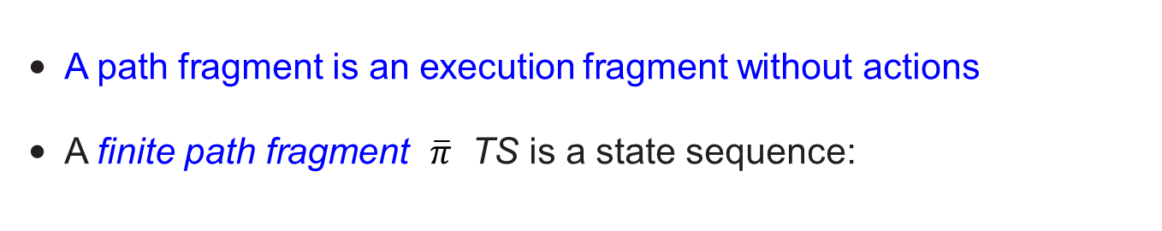
Path fragments
A path fragment is an execution fragment without actions
A finite path fragment $\overline{π}$ TS is a state sequence:
$\overline{π}$ = s₀ s₁ . . . s_{n} such that s_{i+1} ∈ Post(s_{i}) for all 0 <= i < n where n >= 0
An infinite path fragment π of TS is an infinite state sequence:
π =s₀ s₁ s₂ . . . such that s_{i+1} ∈ Post(s_{i}) for all i >= 0
A path of TS is an initial, maximal path fragment
a maximal path fragment is either finite ending in a terminal state, or infinite
a path fragment is initial if s₀ ∈ I
Paths(s) is the set of maximal path fragments π with first(π) = s

Slide 7
Semaphore-based mutual exclusion
PG₁ :
PG₂ :
noncrit₁
noncrit₂
y := y+1
wait₁
y := y+1
wait₂
y > 0 :
y := y−1
y > 0 :
y := y−1
crit₁ crit₂
y=0 means “lock is currently possessed”; y=1 means “lock is free”

Slide 8
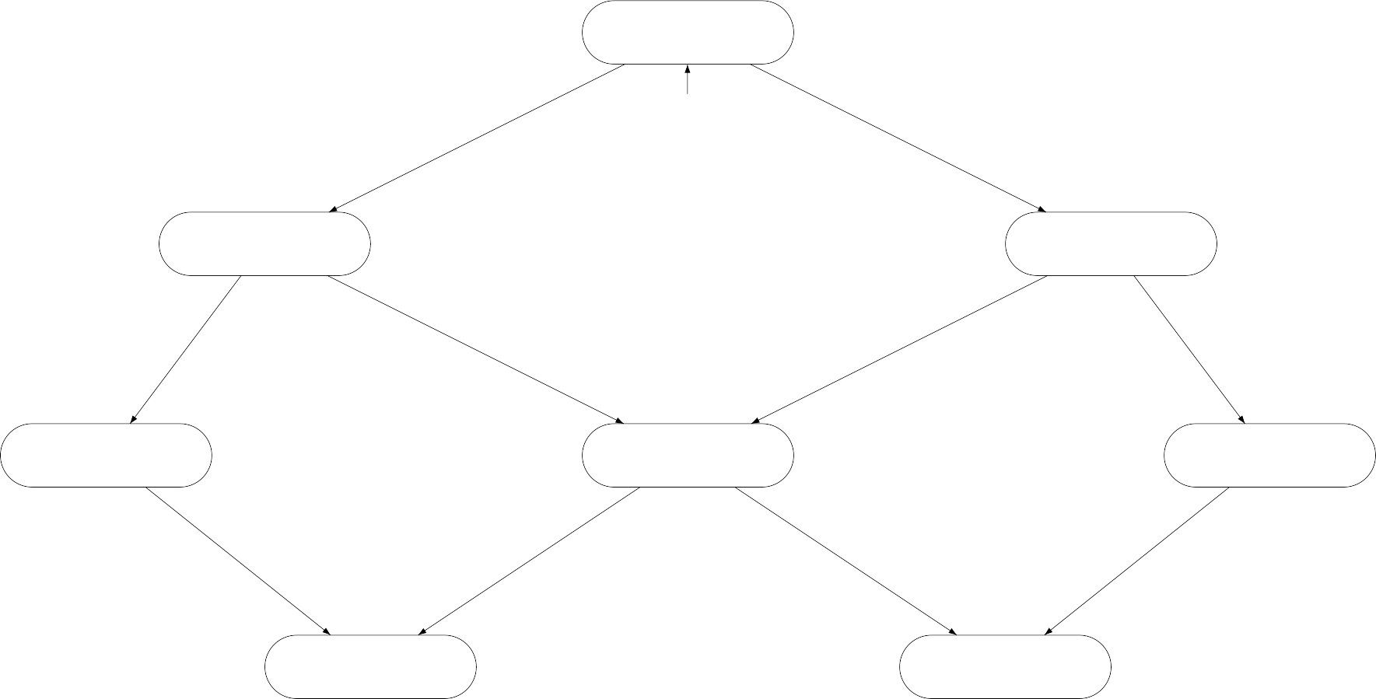
Transition system TS(PG1 ||| PG2)
(n₁, n₂, y=1)
y := y+1
y := y+1
(n₁, w₂, y=1)
(w₁, n₂, y=1)
(c₁, n₂, y=0)
(w₁, w₂, y=1)
(n₁, c₂, y=0)
y := y−1
y := y−1
(c₁, w₂, y=0)
(w₁, c₂, y=0)

Slide 9
Example paths

Slide 10
Traces
Actions are mainly used to model the (possibility of) interaction
synchronous or asynchronous communication
Here, focus on the states that are visited during executions
the states themselves are not “observable”, but just their atomic propositions
Consider sequences of the form L(s₀) L(s₁) L(s₂) . . .
just register the (set of) atomic propositions that are valid along the execution
instead of execution s −−^{α}→⁰ s −−^{α}→¹ s . . .
0 1 2
⇒ this is called a trace
For a transition system without terminal states:
traces are infinite words over the alphabet 2^{AP}, i.e., they are in (2^{AP}) ^{ω}

Slide 11
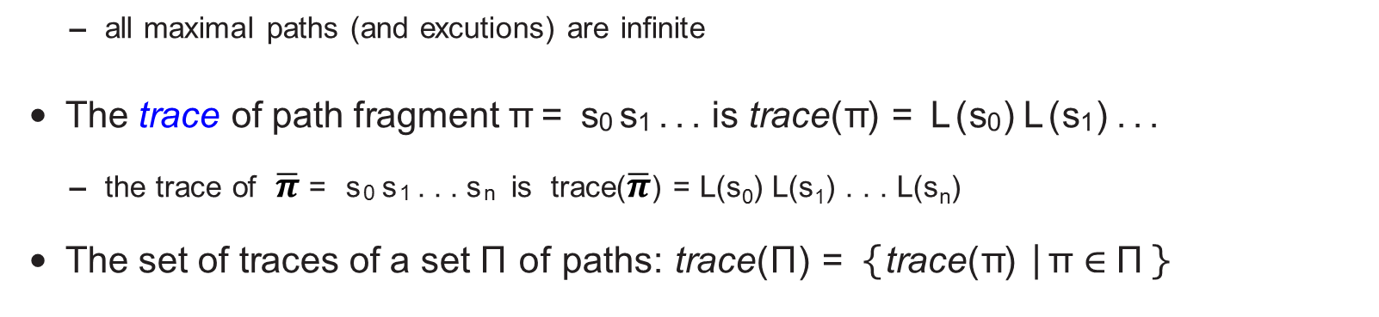
Traces
Let transition system TS = (S, Act, →, I, AP, L) without terminal states.
– all maximal paths (and excutions) are infinite
The trace of path fragment π = s₀ s₁ . . . is trace(π) = L(s₀) L(s₁) . . .
– the trace of $\overline{π}$ = s₀ s₁ . . . s_{n} is trace($\overline{π}$) = L(s₀) L(s₁) . . . L(s_{n})
The set of traces of a set Π of paths: trace(Π) = { trace(π) | π ∈ Π }
Traces(s) = trace(Paths(s)) Traces(TS) = ⋃_{s∈I} Traces(s)
Traces_{fin} (s) = trace(Paths _{fin} (s)) Traces_{fin} (TS) = ⋃s∈ITracesfin (s)

Slide 12
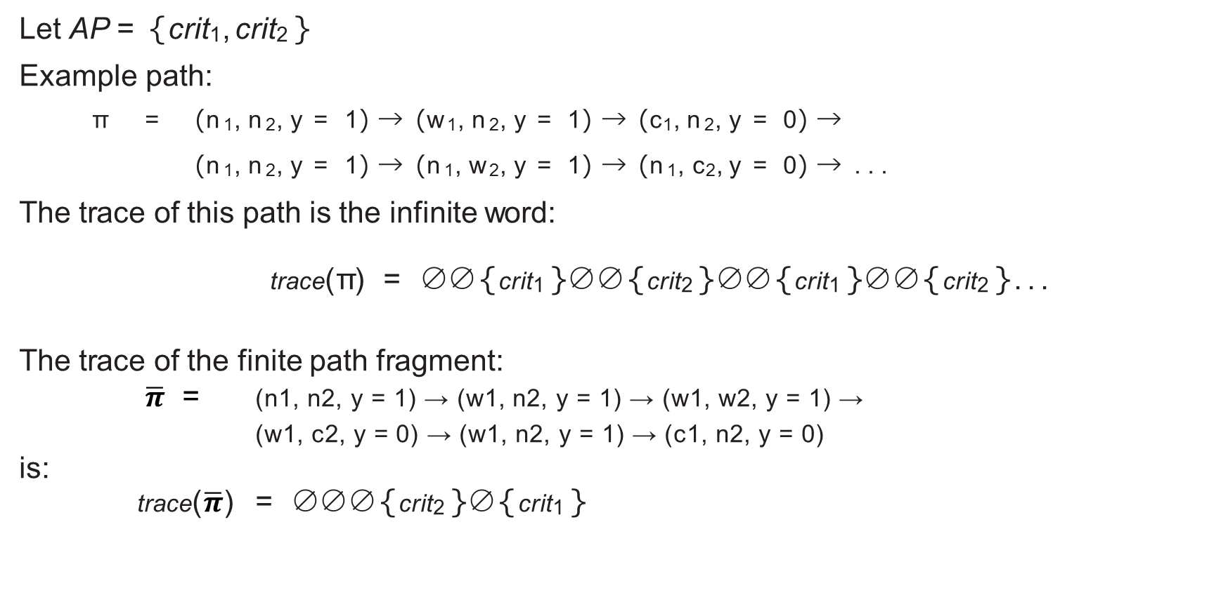
Example traces
Let AP = { crit₁, crit₂ }
Example path:
π = (n₁, n₂, y = 1) → (w₁, n₂, y = 1) → (c₁, n₂, y = 0) →
(n₁, n₂, y = 1) → (n₁, w₂, y = 1) → (n₁, c₂, y = 0) → . . .
The trace of this path is the infinite word:
trace(π) = ∅ ∅ { crit₁ } ∅ ∅ { crit₂ } ∅ ∅ { crit₁ } ∅ ∅ { crit₂ } . . .
The trace of the finite path fragment:
$\overline{π}$ = (n1, n2, y = 1) → (w1, n2, y = 1) → (w1, w2, y = 1) →
(w1, c2, y = 0) → (w1, n2, y = 1) → (c1, n2, y = 0)
is: trace($\overline{π}$) = ∅ ∅ ∅ { crit₂ } ∅ { crit₁ }

Slide 13
Linear-time properties
Linear-time properties specify the traces that a TS must exhibit
LT-property specifies the admissible behaviour of system under consideration
later, a logic will be introduced for specifying LT properties
A linear-time property (LT property) over AP is a subset of (2^{AP} )^{ω}
finite words are not needed, as it is assumed that there are no terminal states
TS (over AP) satisfies LT property P (over AP):
TS |= P if and only if Traces(TS) ⊆ P
TS satisfies the LT property P if all its “observable” behaviors are admissible
state s ∈ S satisfies P , notation s |= P , whenever Traces(s) ⊆ P

Slide 14
How to specify mutual exclusion?
“Always at most one process is in its critical section”
Let AP = { crit₁, crit₂ }
– other atomic propositions are not of any relevance for this property
Formalization as LT property
Pmutex = set of infinite words A0 A1 A2 . . . with { crit1, crit2 } ⫋ Ai for all 0 ⪳ i
Contained in P_{mutex} are e.g., the infinite words:
({ crit₁ } { crit₂ })^{ω} and { crit₁ } { crit₁ } { crit₁ } . . . and ∅ ∅ ∅ . . .
but not { crit₁ } ∅ { crit₁, crit₂ } . . . or ∅ { crit₁ }, ∅ ∅ { crit₁, crit₂ }∅ . . .
Does the semaphore-based algorithm satisfy P_{mutex} ?

Slide 15
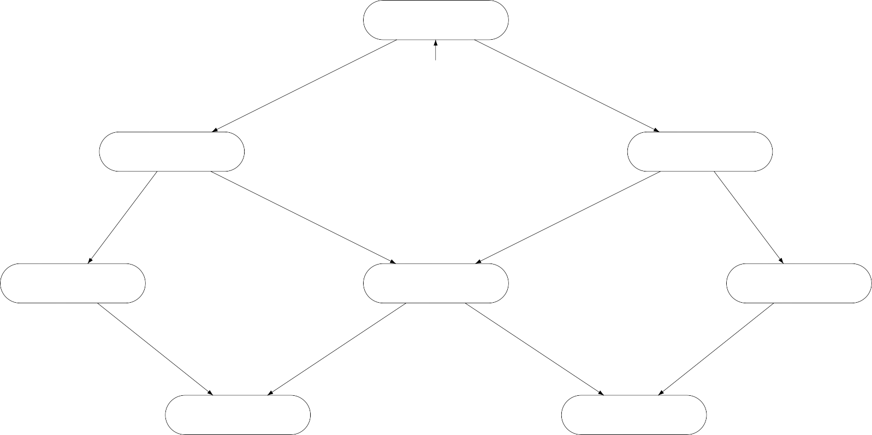
Does the semaphore-based algorithm satisfy Pmutex ?
∅
(n₁, n₂, y=1)
∅
(w₁, n₂, y=1)
∅
(n₁, w₂, y=1)
∅
(w₁, w₂, y=1)
(c₁, n₂, y=0) { crit₁ }
{ crit₂ } (n₁, c₂, y=0)
{ crit₁ } (c₁, w₂, y=0) (w₁, c₂, y=0) { crit₂ }
Yes as there is no reachable state labeled with { crit₁, crit₂ }

Slide 16
How to specify starvation freedom?
“A process that wants to enter the critical section is eventually able to do so‘”
Let AP = { wait₁, crit₁, wait₂, crit₂ }
Formalization as LT-property Pnostarve =set of infinite words A0 A1 A2 . . . such that:
Does the semaphore-based algorithm satisfy P_{nostarve} ?

Slide 17
Does the semaphore-based algorithm satisfy Pnostarve ?
∅
(n₁, n₂, y=1)
{ wait₁ }
(w₁, n₂,y=1)
{ wait₂ }
(n₁, w₂,y=1)
{ wait₁, wait₂ }
(w₁, w₂, y=1)
(c₁, n₂, y=0) { crit₁ }
{ crit₂ } (n₁, c₂, y=0)
{ crit₁, wait₂ } (c₁, w₂, y=0) (w₁, c₂, y=0) { wait₁, crit₂ }
No. Trace ∅ ({ wait₂ } { wait₁, wait₂ } { crit₁, wait₂ } )^{ω} ∈ Traces(TS), but ∉ P_{nostarve}

Slide 18
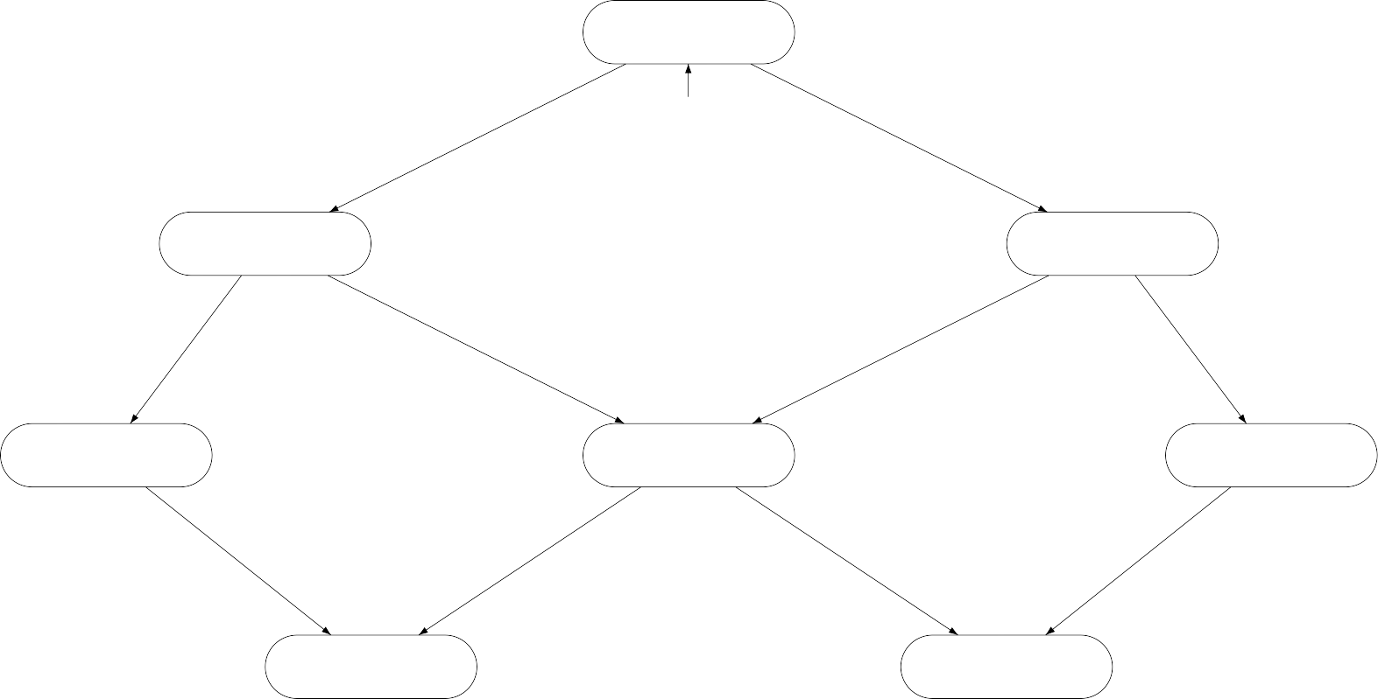
Mutual exclusion algorithm revisited
(n₁, n₂, y=1)
(w₁, n₂, y=1)
(n₁, w₂, y=1)
(c₁, n₂, y=0)
(w₁, w₂, y=1)
(n₁, c₂, y=0)
(c₁, w₂, y=0)
(w₁, c₂, y=0)
this algorithm satisfies P_{mutex}

Slide 19
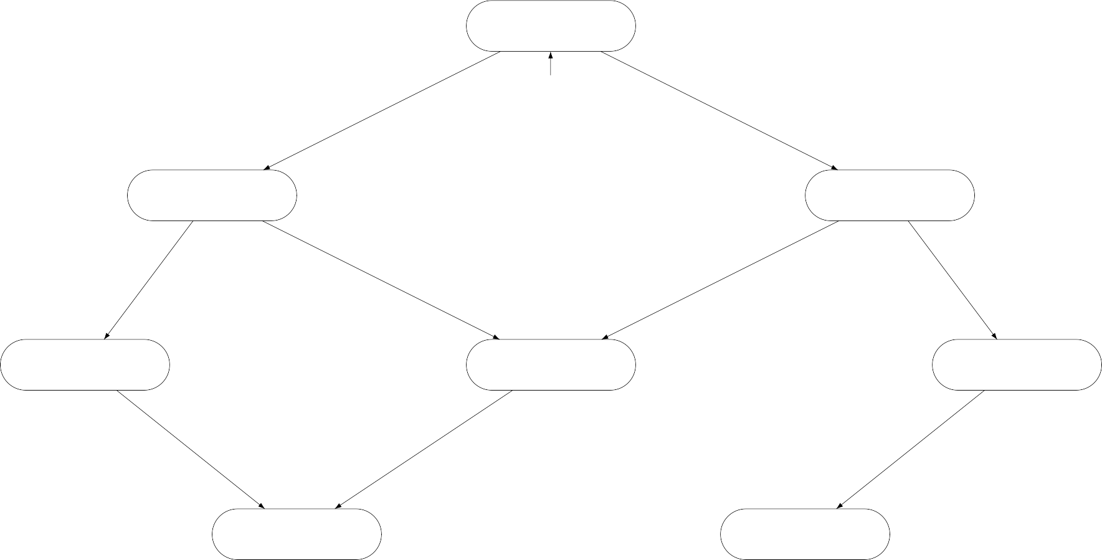
Refining mutual exclusion algorithm
(n1, n2, y=1)
(w₁, n₂, y=1)
(n₁, w₂, y=1)
(c₁, n₂, y=0)
(w₁, w₂, y=1)
(n₁, c₂, y=0)
(c₁, w₂, y=0) (w₁, c₂, y=0)
this variant algorithm with an omitted edge also satisfies P_{mutex}

Slide 20
Trace equivalence and LT properties
For TS and TS′ be transition systems (over AP) without terminal states:
Traces(TS) ⊆ Traces(TS′)
if and only if
for any LT property P : TS′ |= P implies TS|=P
Traces(TS) = Traces(TS′)
if and only if
TS and TS′ satisfy the same LT properties

Slide 21
Two beverage vending machines
pay
pay
τ
τ
τ
sprite
select
beer
select₁
sprite
beer
select₂
τ
AP = { pay , sprite, beer }
there is no LT-property that can distinguish between these machines

Slide 22
Invariants
Safety properties ≈ “nothing bad should happen” [Lamport 1977]
Typical safety property: mutual exclusion property
the bad thing (having > 1 process in the critical section) never occurs
Another typical safety property is deadlock freedom
⇒ These properties are in fact invariants
An invariant is an LT property
that is given by a condition Φ for the states
and requires that Φ holds for all reachable states
e.g., for mutex property Φ ≡ ¬crit₁ ∨ ¬crit₂

Slide 23
Invariants
An LT property P_{inv} over AP is an invariant if there is a propositional logic formula Φ over AP such that:
P_{inv} = { A₀A₁A₂ . . . ∈ ( 2^{AP})^{ω} | ∀j >= 0. A_{j} |= Φ }
– Φ is called an invariant condition of P_{inv}
Note that
TS |= P_{inv} | iff | trace(π) ∈ P_{inv} for all paths π in TS
 | iff iff | L(s) |= Φ for all states s that belong to a path of TS L(s) |= Φ for all states s ∈ Reach(TS)
Φ has to be fulfilled by all initial states and
– satisfaction of Φ is invariant under all transitions in the reachable fragment of TS

Slide 24
Checking an invariant
Checking an invariant for the propositional formula Φ
= check the validity of Φ in every reachable state
⇒ use a slight modification of standard graph traversal algorithms (DFS and BFS)
provided the given transition system TS is finite
Perform a forward depth-first search
at least one state s is found with s |≠ Φ ⇒ the invariance of Φ is violated
Alternative: backward search
starts with all states where Φ does not hold
calculates (by a DFS or BFS) the set ⋃s∈S,s| ≠ Φ Pre∗(s)

Slide 25
A naive invariant checking algorithm
Input: finite transition system TS and propositional formula Φ
Output: true if TS satisfies the invariant ”always Φ”, otherwise false
set of state R := ∅;
stack of state U := ε; bool b := true;
for all s ∈ I do
if s ∈/ R then
visit(s)
fi
od
return b
(* the set of visited states *)
(* the empty stack *)
(* all states in R satisfy Φ *)
(* perform a dfs for each unvisited initial state *)

Slide 26
A naive invariant checking algorithm
procedure visit (state s)
push(s, U );
R := R ∪ { s };
repeat
s′ := top(U );
if Post(s′) ⊆ R then
pop(U );
b := b ∧ (s′ |= Φ);
else
let s′′ ∈ Post(s′) \ R
push(s′′, U );
R := R ∪ { s′′ };
fi
until (U = ε)
endproc
(* push s on the stack *)
(* mark s as reachable *)
(* check validity of Φ in s′ *)
(* state s′′ is a new reachable state *)
error indication is state refuting Φ
initial path fragment s₀ s₁ s₂ . . . s_{n} with s_{i} |= Φ (i ≠ n) and sn |≠ Φ is more useful

Slide 27
Invariant checking by DFS
Input: finite transition system TS and propositional formula Φ
Output: ”yes” if TS |= ”always Φ”, otherwise ”no” plus a counterexample
set of states R := ∅;
stack of states U := ε;
bool b := true;
while (I \ R ≠ ∅ ∧ b) do
let s ∈ I \ R;
visit(s);
od
if b then
return(”yes”)
else
return(”no”, reverse(U ))
fi
(* the set of reachable states *)
(* the empty stack *)
(* all states in R satisfy Φ *)
(* choose an arbitrary initial state not in R *)
(* perform a DFS for each unvisited initial state *)
(* TS |= ”always Φ” *)
(* counterexample arises from the stack content *)

Slide 28
Invariant checking by DFS
procedure visit (state s)
push(s, U );
R := R ∪ { s };
repeat
s′ := top(U );
if Post(s′) ⊆ R then
pop(U );
b := b ∧ (s′ |= Φ);
else
let s′′ ∈ Post(s′) \ R
push(s′′, U );
R := R ∪ { s′′ };
fi
until ((U = ε) ∨ ¬ b)
endproc
(* push s on the stack *)
(* mark s as reachable *)
(* check validity of Φ in s′ *)
(* state s′′ is a new reachable state *)

Slide 29
Time complexity
Under the assumption that
s′ ∈ Post(s) can be encountered in time Θ(|Post(s)|)
⇒ this holds for a representation of Post(s) by adjacency lists
The time complexity for invariant checking is O( N ∗ (1 + |Φ|) + M )
where N denotes the number of reachable states, and
M =∑s∈S |Post(s)| the number of transitions in the reachable fragment of TS
The adjacency lists are typically given implicitly
e.g., by a syntactic description of the concurrent processes as program graphs
Post(s) is obtained by the rules for the transition relation

